Slide 1
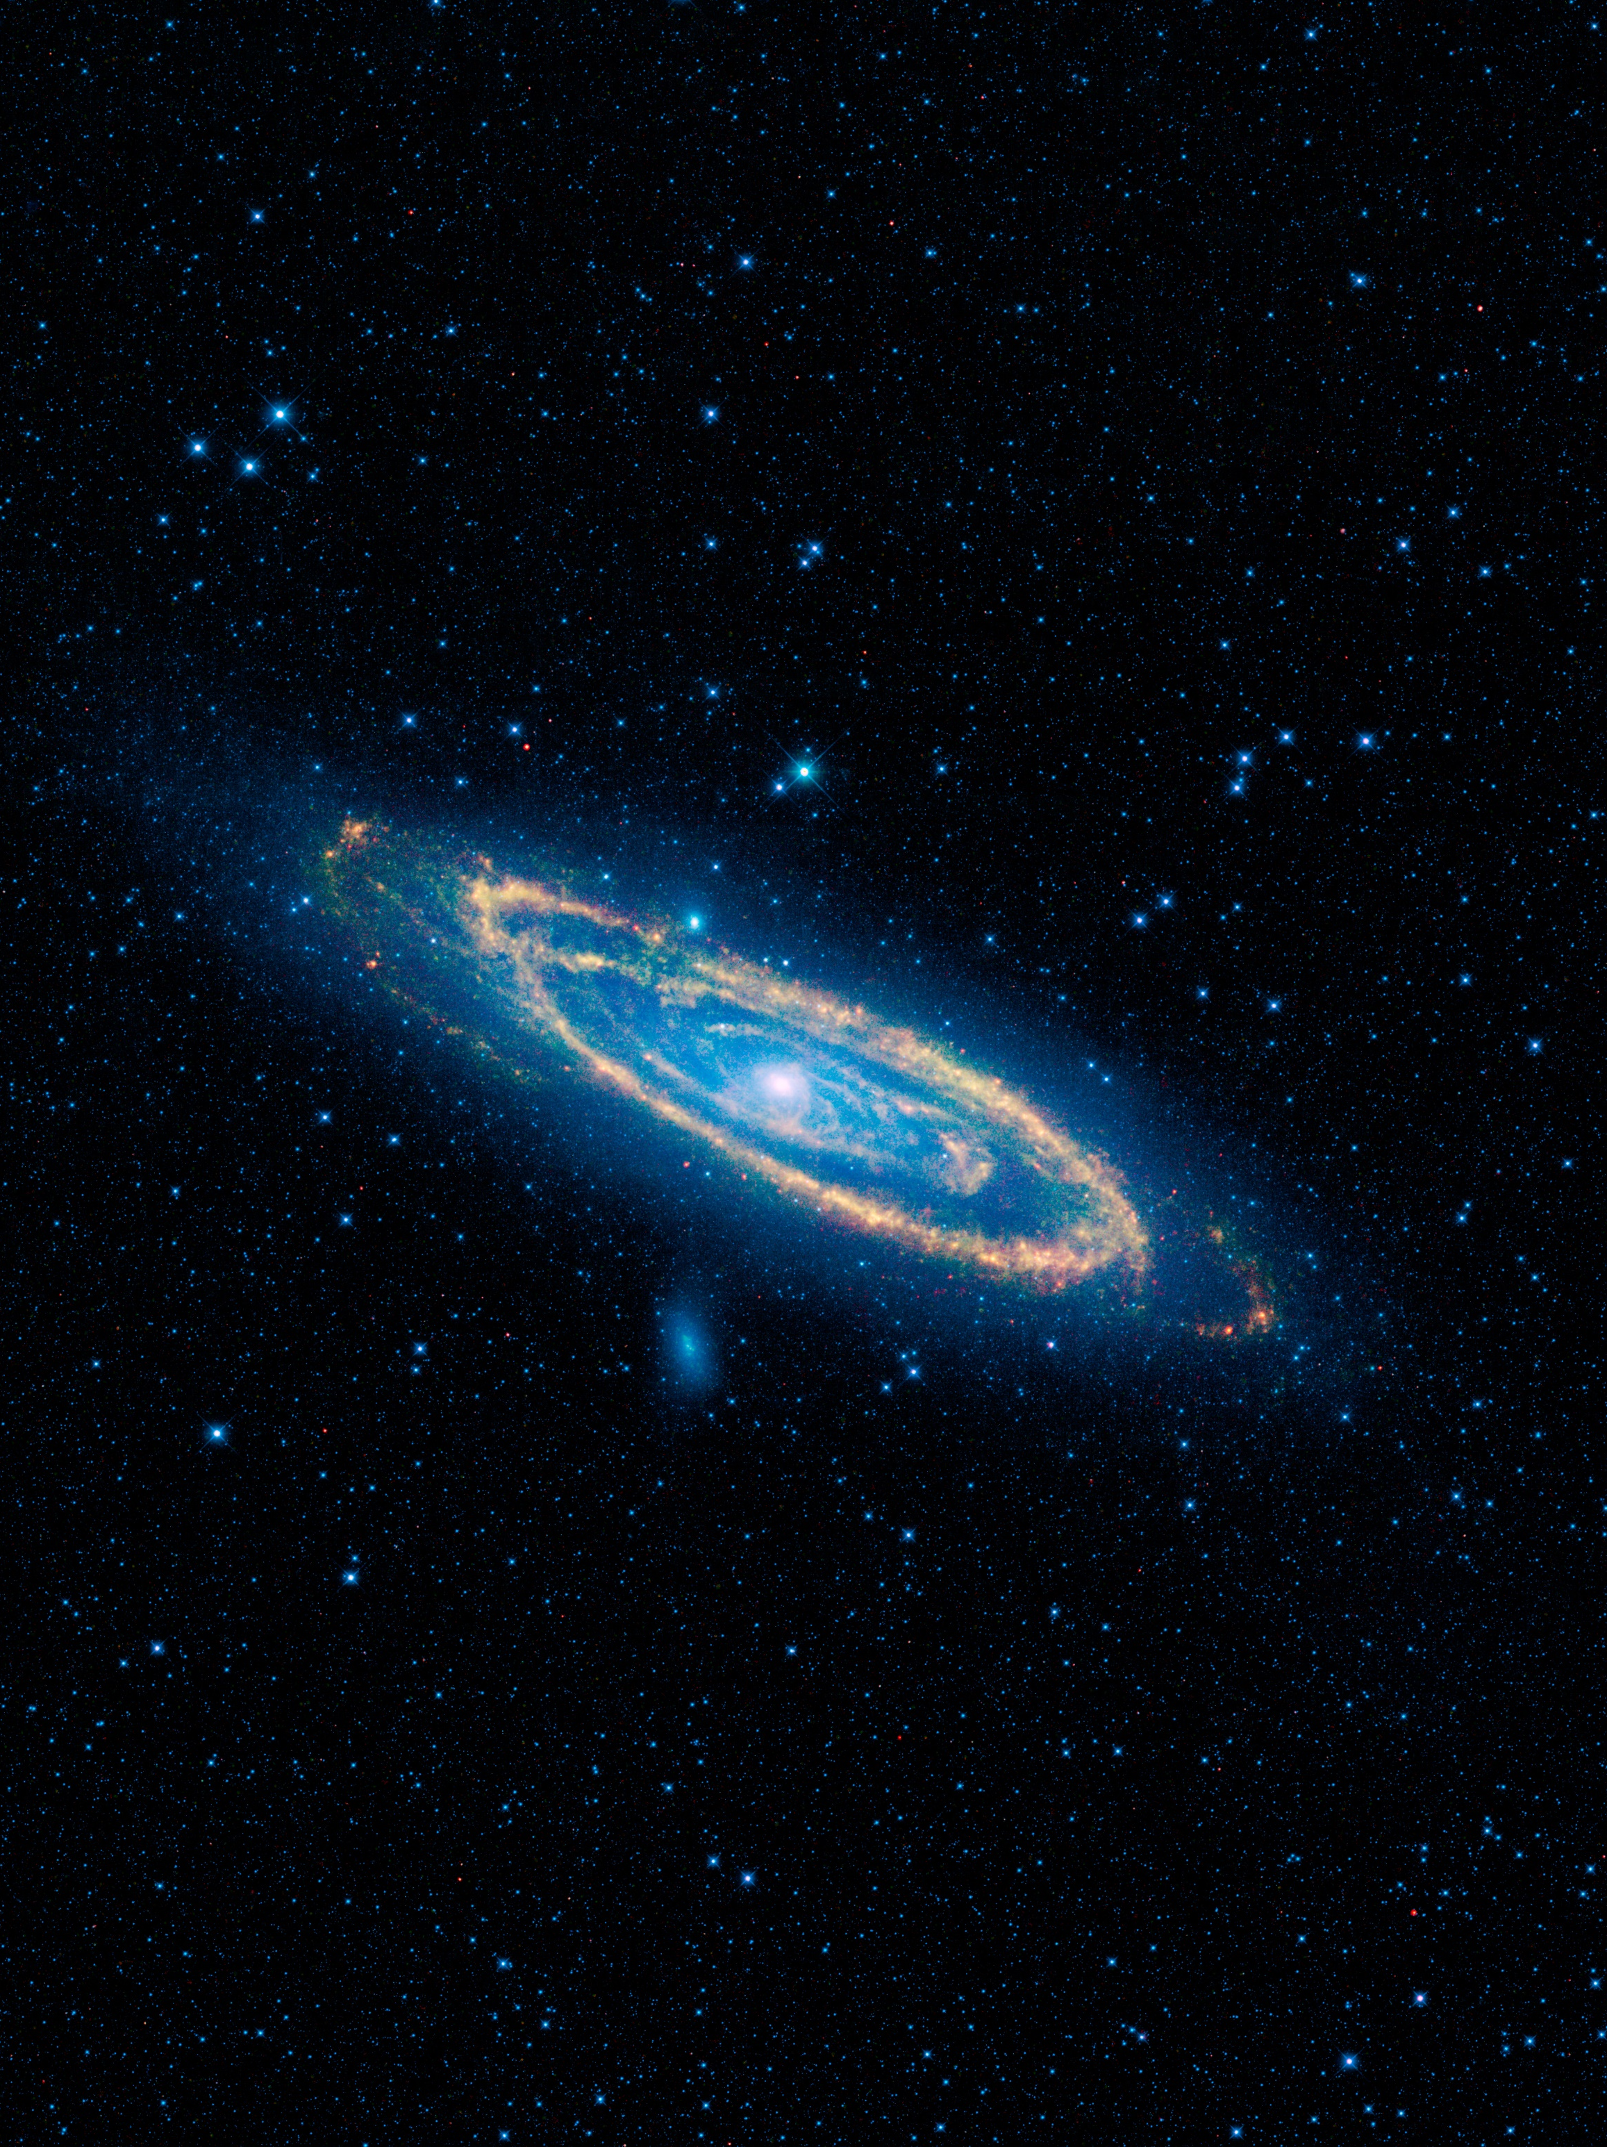
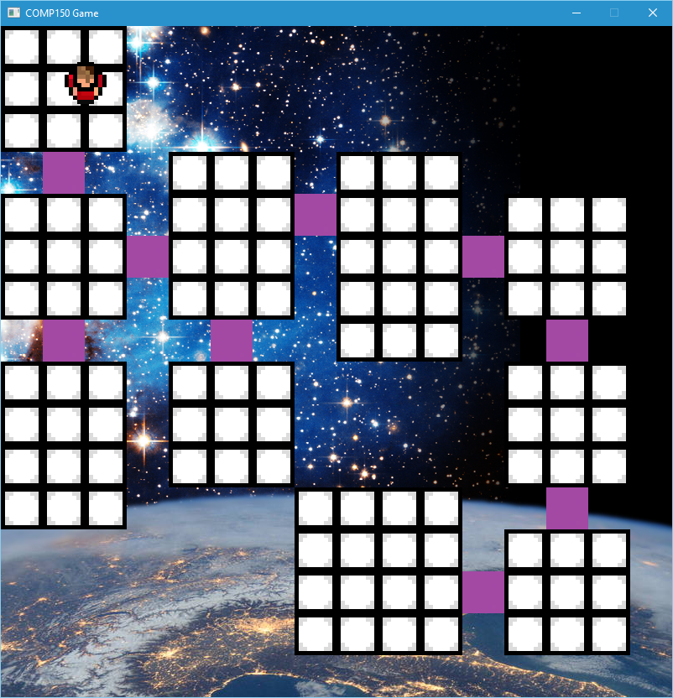
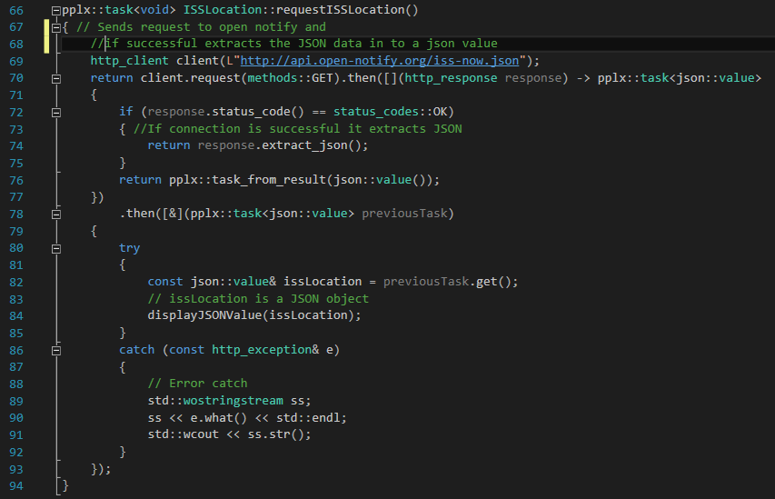
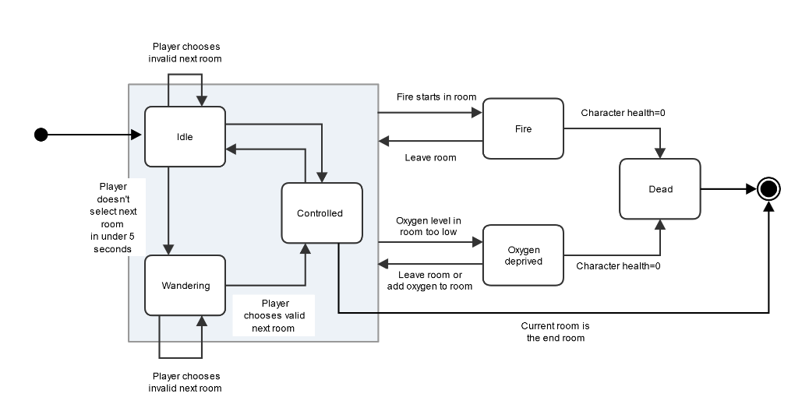
Character AI & Updating Background
Intro
Both the components are used in the COMP150 group game. The first updates the game background based on the location of the ISS. The second is an AI for the character in the game.
Updating Background:
This uses the Open Notify API to get the location of the International Space Station. Using JSON and the C++ REST SDK the code extracts the time and the coordinates from the JSON object and moves the background accordingly. The functions return a pplx::task which allows the data to be extracted in the background and not force the program to wait.
Character AI:
The character AI uses the State design pattern to change the characters state depending on the environment. For example if there is low oxygen the character will move slower and lose health.

